Slide 1






SQL Final project
IPL AUCTION

Slide 2


FIRST WE NEED TO CREATE TABLE AND RESTORE DATA IN IT.

Slide 3
create ipl_ball table:
create ipl_matches table:
create table ipl_ball(
id int,
inning int,
over int,
ball int,
batsman varchar,
non_striker varchar,
bowler varchar,
batsman_runs bigint,
extra_runs int,
total_runs int,
is_wicket int,
dismissal_kind varchar,
player_dismissed varchar,
fielder varchar,
extras_type varchar,
batting_team varchar,
bowling_team varchar);
copy ipl_ball from '/Applications/PostgreSQL 15/DATA/IPL_Ball.csv' CSV header ;
create table ipl_matches(
id int,
city varchar,
date date,
player_of_match varchar,
venue varchar,
neutral_venue int,
team1 varchar,
team2 varchar,
toss_winner varchar,
toss_decision varchar,
winner varchar,
result varchar,
result_margin int,
eliminator varchar,
method varchar,
umpire1 varchar,
umpire2 varchar);
set datestyle to "ISO,DMY"
copy ipl_matches from '/Applications/PostgreSQL 15/DATA/IPL_matches.csv' CSV header ;

Slide 4



Team Roles
Batsman
Bowler
All-Rounder

Slide 5


Batsman
High S.R
Good AVG
Hard Hitter
High Strike Rate
Faced atleast 500 balls
Good Average
Played atleast 2 IPL seasons
High boundary percentage
Played atleast 2 IPL seasons

Slide 6

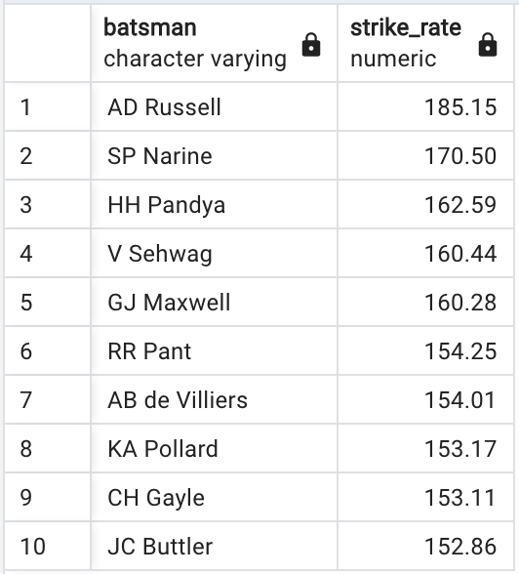
HIGH STRIKE RATE
Query:
RESULT:
SELECT
batsman,
ROUND((SUM(batsman_runs)/COUNT(ball))*100,2) AS strike_rate
FROM ipl_ball
WHERE extras_type = 'NA'
GROUP BY batsman
HAVING COUNT(ball)>500
ORDER BY strike_rate DESC
LIMIT 10;

Slide 7
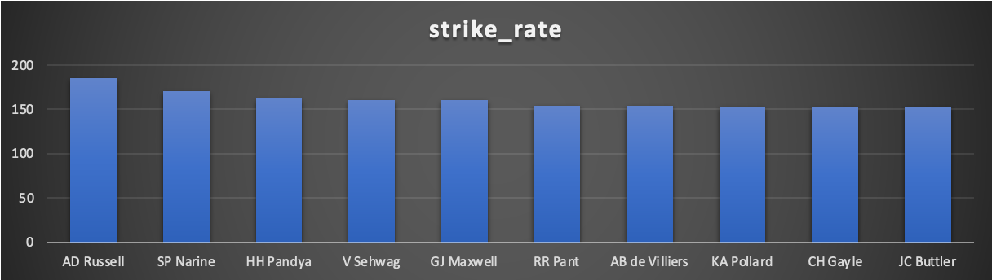
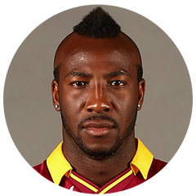
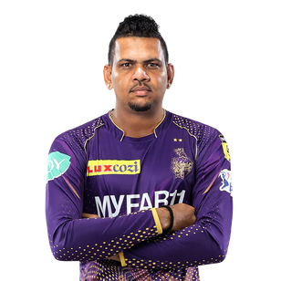
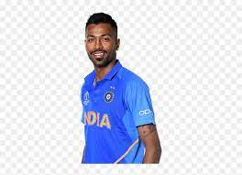
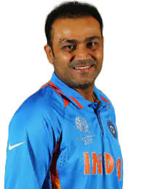
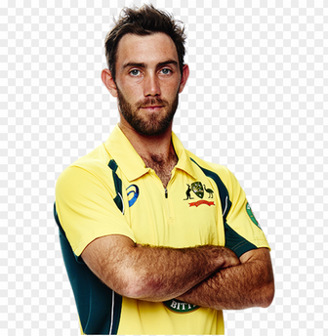
High strike rate Batsman
AD Russell
SP Narine
HH Pandya
V Sehwag
GJ Maxwell
High bids potential

Slide 8
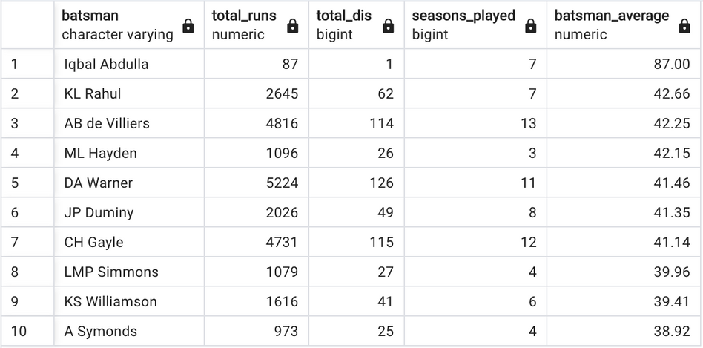
GOOD AVERAGE
Query:
RESULT:
SELECT DISTINCT
b.batsman,
SUM(b.batsman_runs) AS total_runs,
SUM(b.is_wicket) AS total_dis,
COUNT(DISTINCT(EXTRACT(YEAR FROM a.date))) AS seasons_played,
ROUND(SUM(b.batsman_runs)/SUM(b.is_wicket),2) AS batsman_average
FROM ipl_matches AS a
FULL JOIN ipl_ball AS b
ON a.id=b.id
WHERE extras_type= 'NA'
GROUP BY b.batsman
HAVING COUNT(DISTINCT(EXTRACT(YEAR FROM a.date)))>2 AND NOT SUM(b.is_wicket)=0
ORDER BY batsman_average DESC
LIMIT 10;

Slide 9
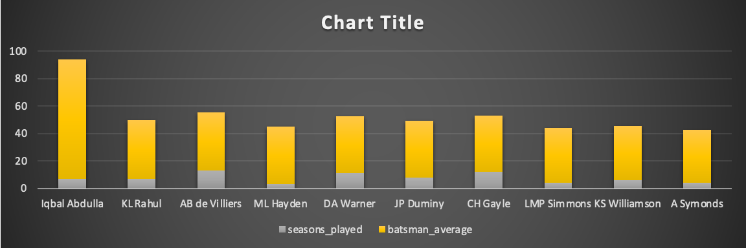





Good Average Batsman
Iqbal Abdulla
KL Rahul
AB de Villiers
ML Hayden
DA Warner
High bids potential

Slide 10
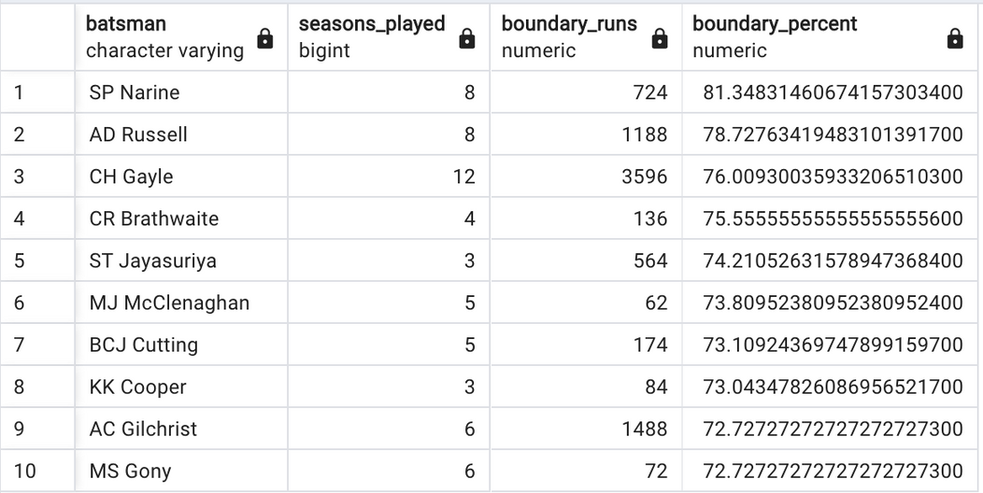
HARD HITTERS
Query:
RESULT:
SELECT DISTINCT
b.batsman,
COUNT(DISTINCT(EXTRACT(YEAR FROM a.date))) AS seasons_played,
SUM(CASE WHEN b.batsman_runs = 4 OR b.batsman_runs = 6 THEN b.batsman_runs ELSE 0 END) AS boundary_runs,
(SUM(CASE WHEN b.batsman_runs = 4 OR b.batsman_runs = 6 THEN b.batsman_runs ELSE 0 END) / SUM(b.batsman_runs)) * 100 AS boundary_percent
FROM ipl_matches AS a
FULL JOIN ipl_ball AS b ON a.id = b.id
WHERE extras_type = 'NA'
GROUP BY b.batsman
HAVING COUNT(DISTINCT(EXTRACT(YEAR FROM a.date))) > 2
ORDER BY boundary_percent DESC
LIMIT 10;

Slide 11
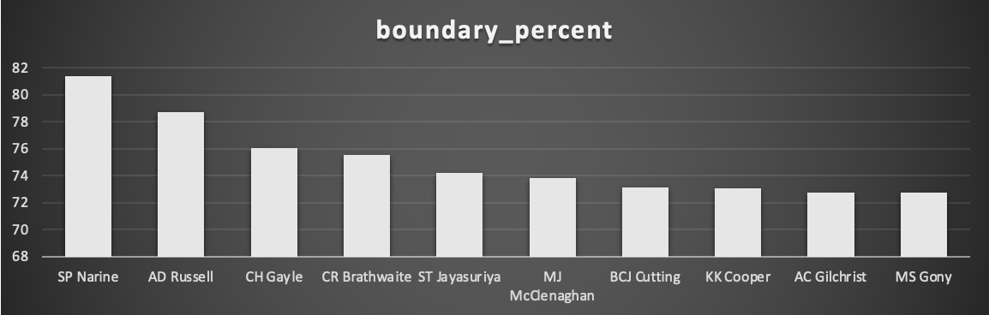

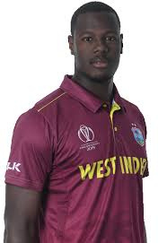
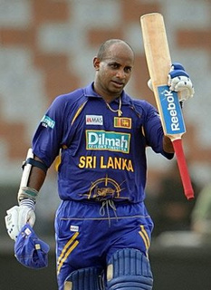
Hard Hitter Batsman
SP Narine
AD Russell
CH Gayle
CR Brathwaite
ST Jayasuriya
High bids potential

Slide 12
Bowlers
Good ECN
Bowler SR
High Economy
Bowled atleast 500 balls
Good bowler striker rate
Bowled atleast 500 balls

Slide 13
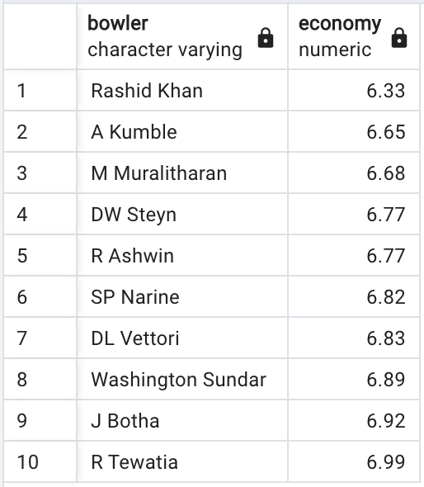
GOOD ECONOMY BOWLERS
Query:
RESULT:
SELECT bowler,
ROUND((SUM(total_runs) / (COUNT(bowler)/6.0)),2) AS economy
FROM ipl_ball
GROUP BY bowler
HAVING COUNT(bowler) >= 500
ORDER BY economy
LIMIT 10;

Slide 14
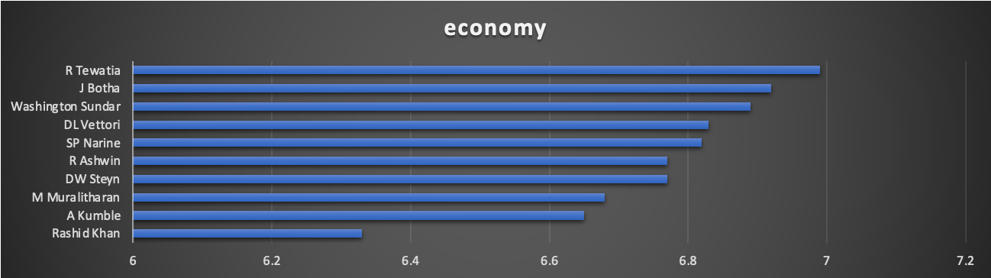
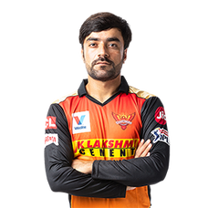
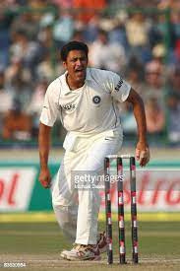
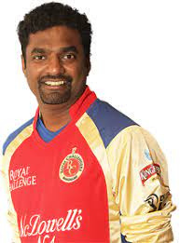
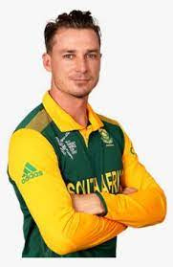
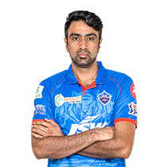
Good Economy Bowlers
Rashid Khan
A Kumble
M Muralitharan
D Steyn
R Ashwin
High bids potential

Slide 15
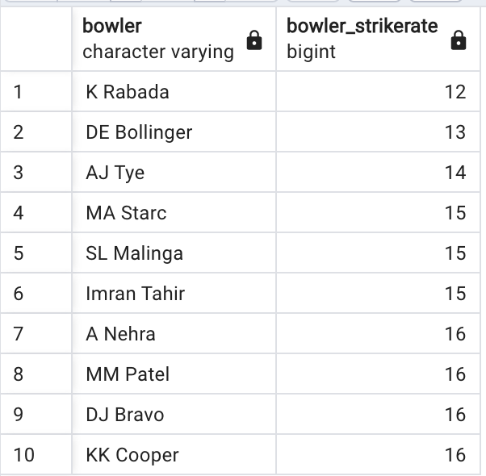
GOOD BOWLER STRIKE RATE
Query:
RESULT:
SELECT
bowler,
COUNT(bowler)/SUM(is_wicket) AS bowler_strikeRate
FROM ipl_ball
GROUP BY bowler
HAVING COUNT(bowler)>500
ORDER BY bowler_strikeRate
LIMIT 10;

Slide 16
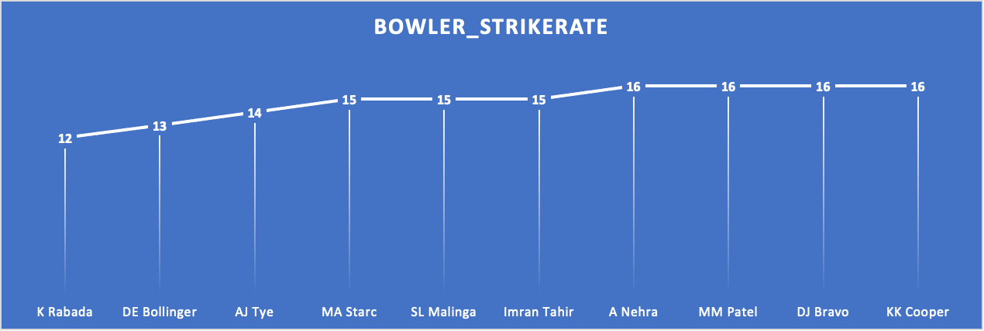
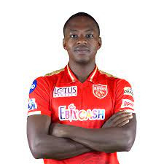
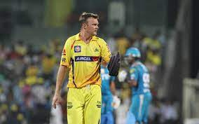


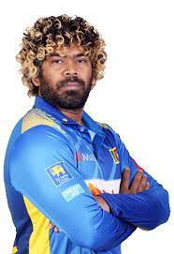
Good strike rate bowlers
K Rabada
DE Bollinger
AJ Tye
MA Starc
SL Malinga
High bids potential

Slide 17
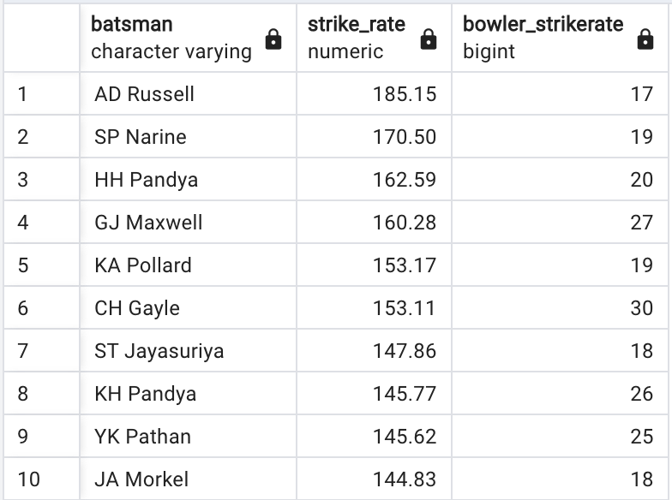
ALL ROUNDER
Query:
RESULT:
SELECT
batsman,
round((SUM(batsman_runs)/COUNT(ball))*100,2) AS strike_rate,
bowler_strikeRate
FROM ipl_ball AS a
INNER JOIN(SELECT
bowler,
COUNT(bowler)/SUM(is_wicket) AS bowler_strikeRate
FROM ipl_ball
GROUP BY bowler
HAVING COUNT(bowler)>300
ORDER BY bowler_strikeRate ASC) AS b
ON a.batsman=b.bowler
WHERE extras_type='NA'
GROUP BY batsman,bowler_strikeRate
HAVING COUNT(ball)>500
ORDER BY strike_rate DESC, bowler_strikeRate ASC
LIMIT 10;

Slide 18
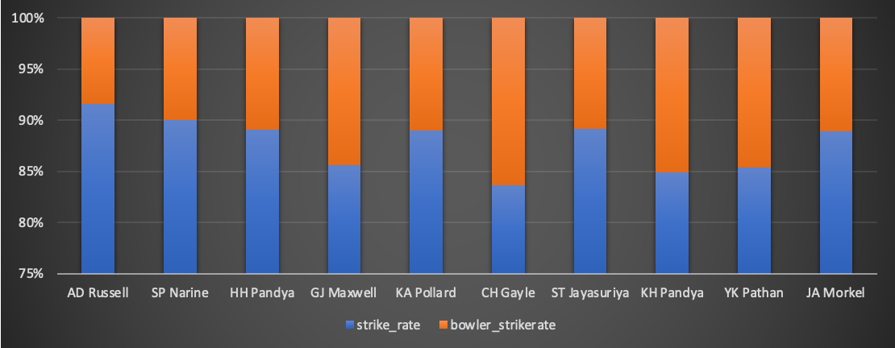
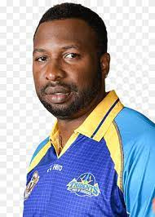
ALL ROUNDER
AD Russell
SP Narine
HH Pandya
GJ Maxwell
KA Pollard
High bids potential

Slide 19

Wicket keeper criteria
Dismissals
Catch/Stumping Rate
Dropped Catches
Stumpings
Runs Saved/Wicket-keeping Average
Batting Average/Strike Rate
Batting Consistency
Error Rate
Diving and Reflex Saves
Matches Played/Availability

Slide 20
ADDITIONAL QUESTIONS

Slide 21
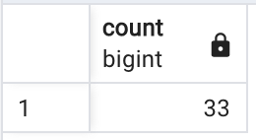
Question 1
Get the count of cities that have hosted an IPL match
Query:
select count(distinct(city)) from ipl_matches;

Slide 22
Question 2
Create table deliveries_v02 with all the columns of the table ‘deliveries’ and an additional
column ball_result containing values boundary, dot or other depending on the total_run
Query:
CREATE TABLE deliveries_v02 AS
SELECT *,
(CASE
WHEN total_runs = 4 or total_runs=6 THEN 'boundary'
WHEN total_runs = 0 THEN 'dot'
ELSE 'other'
END) AS ball_result
FROM ipl_ball;

Slide 23
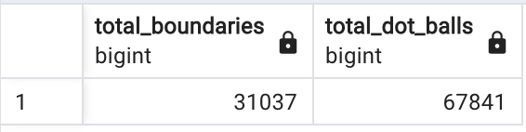
Question 3
Write a query to fetch the total number of boundaries and dot balls from the deliveries_v02 table.
Query:
SELECT
count(CASE WHEN ball_result = 'boundary' THEN 1 END) AS total_boundaries,
count(CASE WHEN ball_result = 'dot' THEN 1 END) AS total_dot_balls
FROM
deliveries_v02;

Slide 24
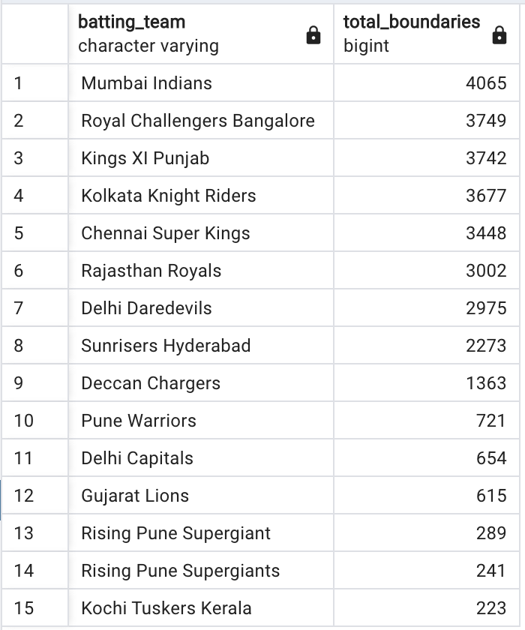
Question 4
Write a query to fetch the total number of boundaries scored by each team from the deliveries_v02 table and order it in descending order of the number of boundaries scored.
Query:
SELECT
batting_team,
COUNT(CASE WHEN ball_result = 'boundary' THEN 1 END) AS total_boundaries
FROM
deliveries_v02
GROUP BY
batting_team
ORDER BY
total_boundaries DESC;

Slide 25
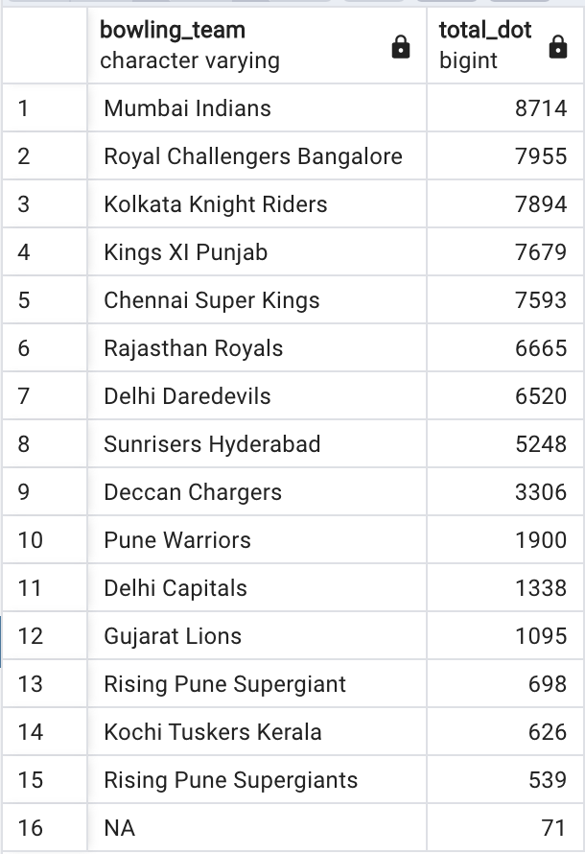
Question 5
Write a query to fetch the total number of dot balls bowled by each team and order it in descending order of the total number of dot balls bowled.
Query:
SELECT
bowling_team,
COUNT(CASE WHEN ball_result = 'dot' THEN 1 END) AS total_dot
FROM
deliveries_v02
GROUP BY
bowling_team
ORDER BY
total_dot DESC;

Slide 26
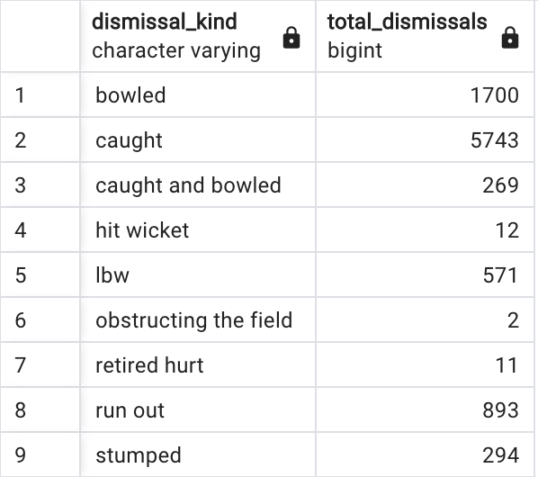
Question 6
Write a query to fetch the total number of dismissals by dismissal kinds where dismissal kind is not NA
Query:
SELECT
dismissal_kind,
COUNT(dismissal_kind) AS total_dismissals
FROM
deliveries_v02
WHERE NOT
dismissal_kind= 'NA'
GROUP BY
dismissal_kind;

Slide 27
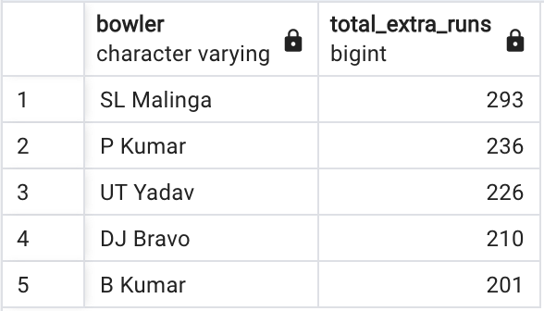
Question 7
Write a query to get the top 5 bowlers who conceded maximum extra runs from the deliveries table
Query:
SELECT
bowler,
SUM(extra_runs) AS total_extra_runs
FROM
ipl_ball
GROUP BY
bowler
ORDER BY
total_extra_runs DESC
LIMIT 5;

Slide 28
Question 8
Write a query to create a table named deliveries_v03 with all the columns of deliveries_v02 table and two additional column (named venue and match_date) of venue and date from table matches
Query:
CREATE TABLE deliveries_v03 AS
SELECT a.*, b.venue, b.date
FROM deliveries_v02 as a
full JOIN ipl_matches as b
ON a.id = b.id;

Slide 29
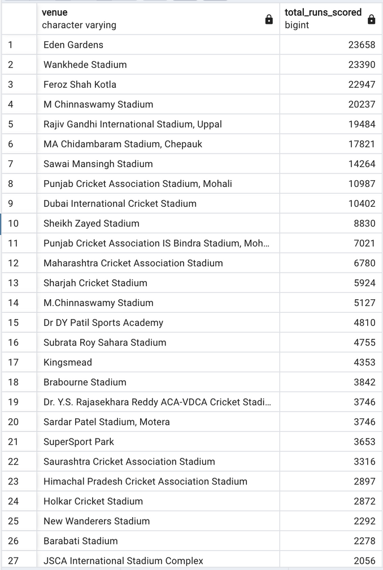
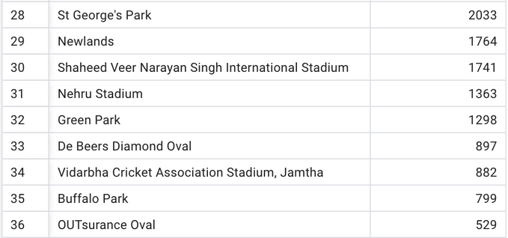
Question 9
Write a query to fetch the total runs scored for each venue and order it in the descending order of total runs scored.
Query:
SELECT
venue,
SUM(total_runs) AS total_runs_scored
FROM
deliveries_v03
GROUP BY
venue
ORDER BY
total_runs_scored DESC;

Slide 30
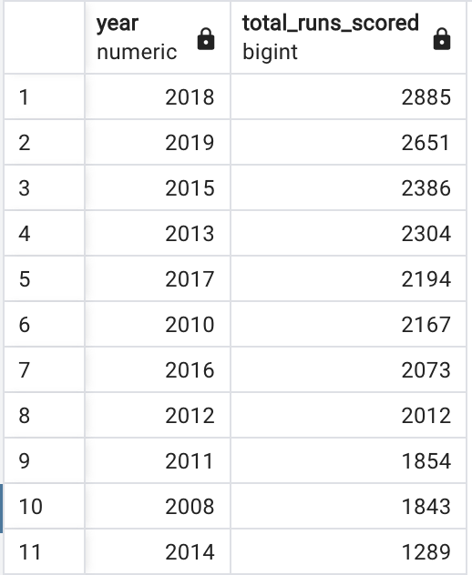
Question 10
Write a query to fetch the year-wise total runs scored at Eden Gardens and order it in the descending order of total runs scored.
Query:
SELECT
EXTRACT(YEAR FROM date) AS year,
SUM(total_runs) AS total_runs_scored
FROM
deliveries_v03
WHERE
venue = 'Eden Gardens'
GROUP BY
year
ORDER BY
total_runs_scored DESC;

